Slide 1
Object Oriented Programming
Lecture 02

Slide 2
Compilation process
Source code assembly language
  source code
  pre-processor
  intermediate file
  syntactic analysis
  tree of syntactic analysis
  optimisation
  optimised code (.o, .obj)
  linker (unification of modules)
  execute file (.exe)
Translator (compiler, interpreter)
February, 23 2010
OOP

Slide 3
Separate compilation
Pieces of code can be compiled separately and combined (by the linker) into the final executable program
Benefits:
  A program that exceeds the limits of the compiler can be compiled in pieces
  Programs are built and tested one piece at time
  Collection of tested and working pieces can be combined in libraries
  The complexity of each part is hidden
February, 23 2010
OOP

Slide 4
Data types
Type | Size (# bytes) | Minim value | Maxim value | Pascal type
unsigned char | 1 | 0 | 255 | byte
char | 1 | -128 | 127 | shortint
int | 2 or 4 | -32 766 - 2 147 483 648 | 32 767 2 147 483 647 | integer
unsigned int | 2 or 4 | 0 | 65 535 2 147 483 647 | word
short | 2 | -32 768 | 32 767 | integer
unsigned short | 2 | 0 | 65 535
long | 4 | -2 147 483 648 | 2 147 483 647 | longint
unsigned long | 4 | 0 | 4 294 967 295
float | 4 | -3.4E-38 | 3.4E38 | real
double | 8 | 1.7E-308 | 1.7E+308
long double | 10 | 3.4E-4932 | 1.1E4932
February, 23 2010
OOP

Slide 5
Language elements
Default conversions
  char→int,
  float→double,
  (double,*)→(double,double)=double,
  (long,*)→(long,long)=long,
  (unsigned,*)→(unsigned,unsigned)=unsigned
Operator priority (decreasing order)
  ( ), []
  -, +, *, & (unary), !, ~, (tip), sizeof, ++, --
  *, /, %
  +, -,
  <<, >>
  <, <=, >, >=
  ==, !=
  &
  ^
  |
  &&
  ||
  ? :(ternary)
  =, *=, /=, %=, +=, −=, <<=, >>=, &=, ^=, |=
  ,
February, 23 2010
OOP

Slide 6
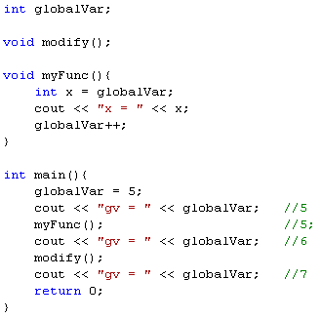

Variable visibility
file1.cpp
Scope
  where a variable is:
    valid
    created
    destroyed
Global variables
  defined outside all function bodies
  available to all parts of the program
  the lifetime lasts until the program ends
  extern
    To be used in other file(s)
    the variable exists, even if the
    compiler hasn’t yet seen it in the file
    currently being compiled
file2.cpp
February, 23 2010
OOP

Slide 7
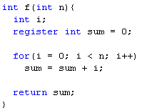
Variable visibility
Local variables
  occur within a scope ➔ automatic variables (automatically come into being and automatically disappear at the end of the scope)
  are “local” to a function
  register variables (possibly stored in registers)
    “register” – tells the compiler “make access to this
    variable as fast as possible” > it is a hint tot the
    compiler > not sure the speed will be increased
    can be declared only within a block or as a parameter
      not static or global register variables
    cannot take or compute the address of a register variable
February, 23 2010
OOP

Slide 8
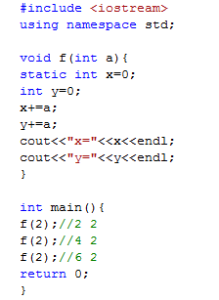
Variable visibility
Static variables
  allocated in the program memory
  non-static variables are allocated on the stack
  only one automatically initialisation
    first function call
    allows functions to “remember” some pieces of information between calls
  static meanings:
    unavailable outside the scope of the function
      in order to memorise some information about local variables from a call to another call
    unavailable outside of the file
      for global variables or functions
    classes
February, 23 2010
OOP

Slide 9
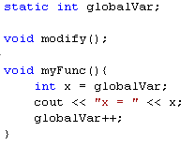
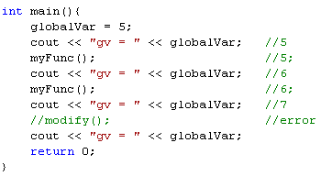

Static variables
file1.cpp
file2.cpp
February, 23 2010
OOP

Slide 10
Constants
C approach – uses the pre-processor
  #define PI 3.14
  The value of PI is substituted everywhere by the pre-processor by 3.14
  The control is outside the compiler
  No type checking is performed on the name PI
  You cannot take the address of PI
  The meaning of PI lasts from the point it was defined to the end of the file (preprocessor doesn’t know about scoping)
February, 23 2010
OOP

Slide 11
Constants
C++ approach – concept of named constant (similar to a variable, but the value cannot change)
Uses the modifier const
Any data type (built-in or user-defined) can be used with const
If you attempt to modify it>compiler error
const can be used in argument lists
A const has a scope, just like a regular variable
A const must always have an initialization value
February, 23 2010
OOP

Slide 12
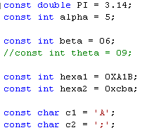
Constants
  Types
    numeric
      decimal: 123, 111
      octal: 077
      hexadecimal: 0XAABE
      floating-point: 2.3456, 6.023e23
    Char – surrounded by single quotes ‘’
      printable: ‘a’, ‘P’, ‘”’
      functional: '\b'=backspace, '\r'=return, '\n'=newline, '\''=apostrophe, '\\'=backslash, '\v'=verticalTab, '\f'=newPage, '\0'=null
    String
      “mesage”
February, 23 2010
OOP

Slide 13
Functions
C++ uses function prototyping – you must use a description of the arguments types when declaring and defining a function
When the function is called the compiler checks that the proper arguments are passed and that the returned value is treated correctly
The formal parameter list contains the type of arguments and optionally identifiers
The order and the type of the arguments must match in declaration, definition and call
Remark: you must indicate the type for each argument!
February, 23 2010
OOP

Slide 14

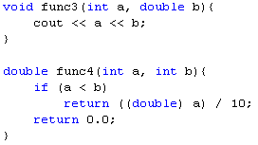
Functions
Declaration
e.g.
Definition
e.g.
<return_type> <fc_name>([<formal_param_list>]);
<return_type> <fc_name>([<formal_param_list>]){
statements;
}
February, 23 2010
OOP

Slide 15

Functions – arguments list
Empty arguments list
Variable arguments list
February, 23 2010
OOP

Slide 16
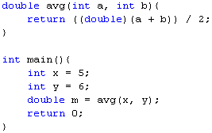
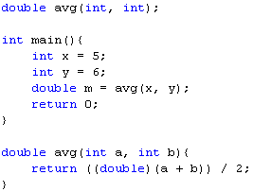
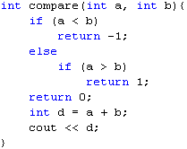
Function return values
The return type specification precedes the function name
To specify that no value is returned – void
To return a value from a function – return statement
Return – the last statement that is executed – exits the function back to the point right after the function call
If the return statements has an argument – the argument becomes the return value of the function
There can be more than one return statement in a function
February, 23 2010
OOP

Slide 17

Inline functions
Declared by adding the “inline” keyword in front of function definition
Effect: any call of the function will be replaced by the function body
Advantage: eliminates the overhead of performing a function call and copying the arguments when the function is executed
Restrictions:
  No loops
  About 3 statements
The call s=sum(x,12) is replaced by s=x+12;
“inline” – recommendation to the compiler – not sure it will be inline
February, 23 2010
OOP

Slide 18
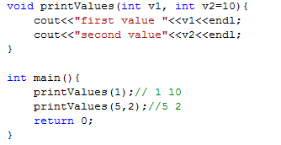
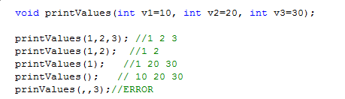
Function with default parameters
Default parameter = function parameter that has a default value provided to it
If the user of the function does not supply a value for this parameter, the default value will be used
If the user supplies a value for the default parameter, it will be used
All default parameters must be the rightmost parameters
-----
February, 23 2010
OOP

Slide 19
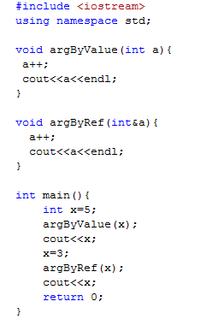
Functions
Passing arguments
  by value
  by reference (&)
    any modification to the reference inside the function will cause changes to the argument outside the function
February, 23 2010
OOP

Slide 20
Functions with variable number of parameters
When a function is declared, the data-type and number of the passed arguments are usually fixed at compile time.
sometimes we require a function to be able to accept a variable number of arguments.
The data-type and/or number of the passed arguments are provided at the run-time.
passing variable number and type of arguments is supported by the <cstdarg> library
February, 23 2010
OOP

Slide 21
Functions with variable number of parameters
<cstdarg> provides:
  the va_list data-type, which can contain the list of arguments passed into a function
  the macros : var_arg, va_start, and va_end that are useful for manipulating the argument-list.
  va_start - a macro used to initialize the argument list so that we can begin reading arguments from it. It takes two arguments : (a) the va_list object which stores the passed arguments, and (b) the last named argument, after which the number of arguments is variable.
  va_arg - the macro used to read an argument from the list. It takes two parameters: (a) the va_list object we created, and (b) a data type. va_arg returns the next argument as this type
  va_end - a macro that cleans up our va_list object when we're done with it.
February, 23 2010
OOP

Slide 22
Exemplu
#include <cstdio>
#include <cstdarg>
#include <iostream>
using namespace std;
int FindMax ( int count, ...)
{
int i,val,greater;
va_list vl;
va_start(vl,count);
greater=va_arg(vl,int);
for (i=1;i<count;i++)
{
val=va_arg(vl,int);
greater=(greater>val)?greater:val;
}
va_end(vl);
return greater;
}
int sum(int first, ...){
int s=0,aux;
va_list argList;
va_start(argList,first);
s+=first;
aux=va_arg(argList,int);
while(aux!=-1) {
s+=aux;
aux=va_arg(argList,int);
}
va_end(argList);
return s;
}
int main ()
{
int m;
m= FindMax (7,702,422,631,834,892,104,772);
cout<<"The greatest one is: "<<m<<endl;
cout<<"The sum of numbers is: "<<sum(2,3,4,-1)<<endl;
return 0;
}
February, 23 2010
OOP

Slide 23
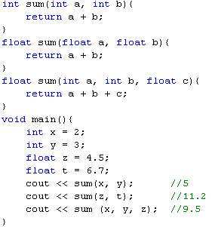
Functions overloading
  The practice of declaring the same function with different signatures
  The same function name will be used with
    different parameter types
    different number of parameters
  Overloading functions with different return types is not allowed
February, 23 2010
OOP

Slide 24
Structured data types
Vectors
Structures
Unions
Enumerations
February, 23 2010
OOP

Slide 25


Arrays
Declaration
E.g.
Usage
  element access: by [] operator
    v1[1], v2[3], matrix[i][j]
  Zero indexing - the first element is on position 0
<elem_type> <identif>[dim_1][dim_2]…[dim_n]
vector
0 1 2 3 4
v1
2 13 8
0 1 2
v2
1 5 0 0 0
0 1 2 3 4
February, 23 2010
OOP

Slide 26


Arrays
Multidimensional arrays
  Declaration
    all dimensions must be specified
  Initialisation
  dim2, dim3,…must be specified
February, 23 2010
OOP

Slide 27

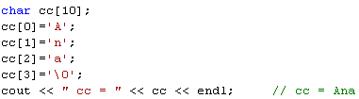

Arrays
Arrays of chars
  declaration & initialisation
    similar to other arrays
  representation
    on n positions
    ends by ‘0’ (NULL char)
s1
s t o p
0 1 2 3
s2
s t o p \0
0 1 2 3 4
February, 23 2010
OOP

Slide 28
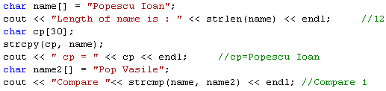
Strings
headers: <cstring> (C++) or <string.h> (C)
  functions for string parsing
    strlen – length of a string
    strcpy – copy a string into another string
    strcat – concatenate 2 strings
    strcmp – compare 2 strings
      strcmp(s1, s2)= -1, if s1 < s2
      strcmp(s1, s2)= 0, if s1 = s2
      strcmp(s1, s2)= 1, if s1 > s2
February, 23 2010
OOP

Slide 29
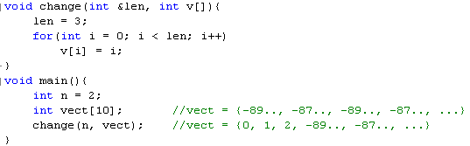
Arrays
Arrays as function parameters
  Always sent by reference
February, 23 2010
OOP

Slide 30
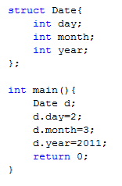
Structures
Similar to Pascal records
Declaration
To select the components of a structure use the “.” operator
struct [<identif>] {
type1 field1;
type2 field2;
…
}[variab_list];
February, 23 2010
OOP

Slide 31
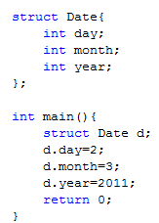
Structures
The C approach:
February, 23 2010
OOP

Slide 32
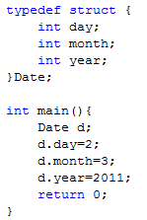
Aliasing names with typedef
Ex: typedef unsigned long ulong;
ulong a;
typedef <existing_type> <alias_name>
February, 23 2010

Slide 33
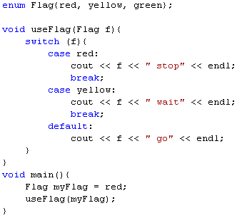
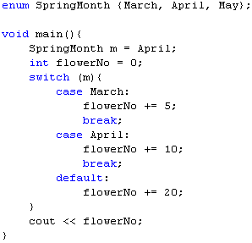
Enumerations
A way of attaching names to numbers
Declaration
usage
enum <identif>{id0[=expr0], id1[=expr1], …, idn[=exprn]}[var_list]
February, 23 2010
OOP

Slide 34
Enumerations
In order to assign particular values to the components of an enumeration:
If you give values to some names and to others you don’t, the compiler will use the next integral value
enum Shape{circle=10, square=20, rectangle=50}
enum Colors{red=10, black}
11
February, 23 2010

Slide 35
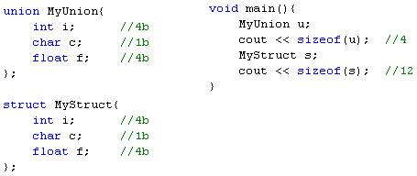
Unions
union <identif>{
type1 field1;
type2 field2;
…}[var_list];
Declarations
Usage
Advantages
  save memory
  piles all the data into a single space;
  it figures out the amount of space necessary for the largest item you’ve put in the union, and makes that the size of the union
February, 23 2010
OOP

Slide 36
Header files
Header file- file containing the external declarations for a library
Conventionally has a filename extension of ‘h’
The programmer who creates the library provides the header file
To include a header file – the pre-processor directive #include is used – the pre-processor will open the named header file and will insert its content where the #include directive occurs
February, 23 2010
OOP

Slide 37
Header files
The code of a C++ program is split in a number of source files:
  *.h – file containing the declarations
  *.cpp - filecontaining the implementation
Advantage:
  the cpp file is compiled separately
February, 23 2010
OOP

Slide 38
Header files - remarks
When the *.h file is changed, all the files that include (directly or indirectly) it must be recompiled
The header file is a CONTRACT between the developer and the client of the library that describes the data structures and states the arguments and return values for function calls
The compiler enforces the contract by requiring the declarations for all structures and functions before they are used = include the header file
What to put into header files? Only declarations, nothing that allocates storage!
February, 23 2010
OOP

Slide 39
Header files- multiple declaration problem
If a struct declaration belongs to a header file, it is possible for the file to be included more than once in a complex program (eg: iostreams)>error (multiple declaration)
Solution: use the pre-processor
Pre-processor directives: #ifdef, #ifndef, #define, #endif
Ex: #define FLAG (label)
The label can be tested by the pre-processor to see if it has been defined
February, 23 2010
OOP

Slide 40
Header files
#ifdef FLAG
  If FLAG is already defined, the code following to #ifdef is sent to the compiler
The inclusion ends with #endif
#ifdef/#endif can be nested
The complement of
  #ifdef - #ifndef
  #define - #undef
February, 23 2010
OOP

Slide 41
The standard for header files
In each haeder file that contains a structure you must check that the header file wasn’t already included by testing the pre-processor flag
If the flag isn’t set, the file wasn’t included, otherwise, the type has already been declared
#ifndef HEADER_FLAG
#define HEADER_FLAG
//declarations
#endif
#pragma once – not portable
February, 23 2010
OOP

Slide 42
Example
Let P be a polynomial. Write a C++ program to compute the value of the polynomial in a given point.
Structure of the solution: project containing the following files:
  Polynomial.h – data type definition+declarations>exports a new data type
  Polynomial.cpp – implementation (the client will get only the compiled file)
  Test.cpp – how to use the exported data-type from “Polynomial.h”
February, 23 2010
OOP

Slide 43
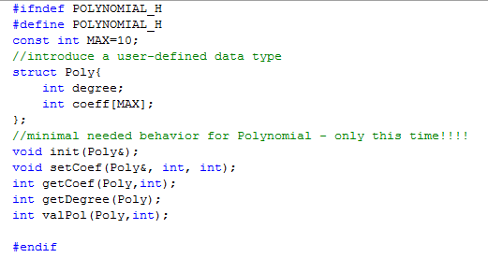
Polynomial.h
February, 23 2010
OOP

Slide 44
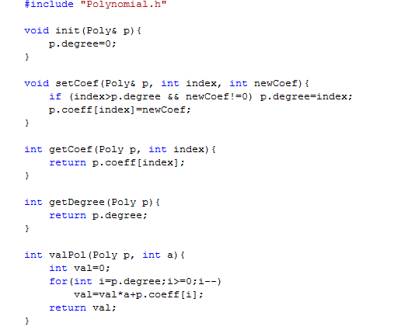
Polynomial.cpp
February, 23 2010
OOP

Slide 45
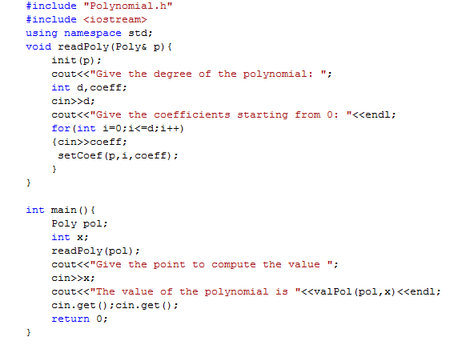
Test.cpp
February, 23 2010
OOP

